Slide 1
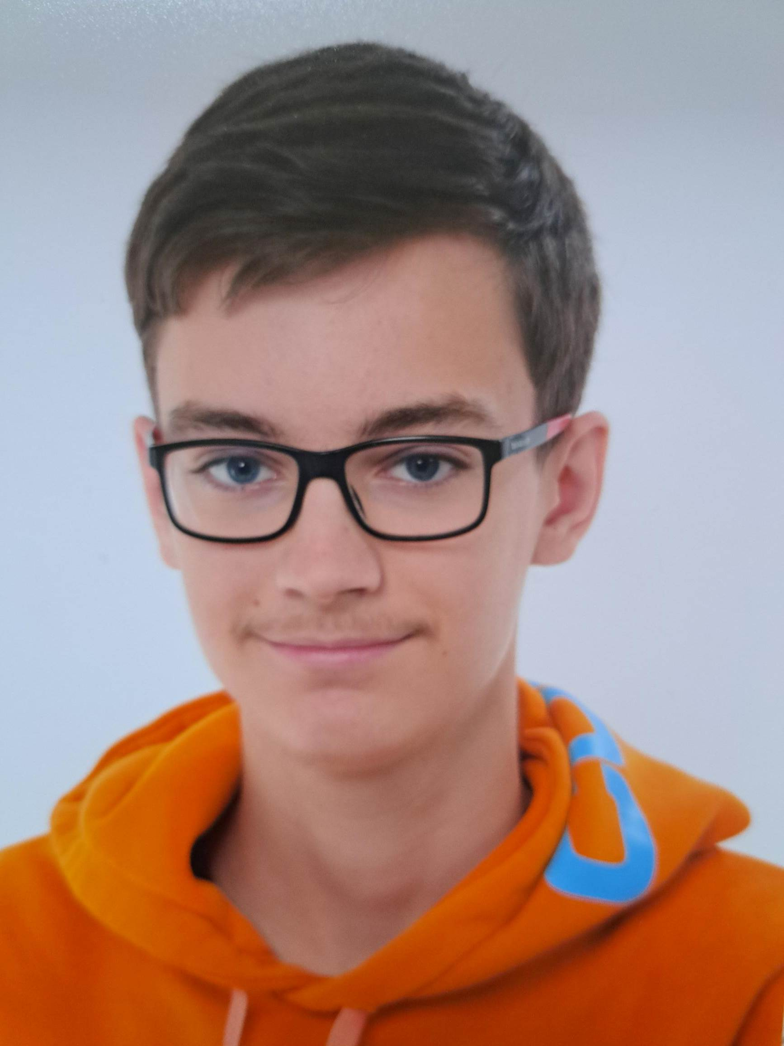
Maks Burchard
240894
Data Understanding and Preparation
Learning Log
Year 1
Block B
Hyperlink
Hyperlink
https://github.com/BredaUniversityADSAI/2024-25b-fai1-adsai-MaksBurchard240894

Slide 2

How To Use
This Template
As a student at Breda University of Applied Sciences studying to become a professional, you are required to provide evidence that demonstrates your professional learning and growth during the block. This template is intended to provide you with a well-structured and organised format for doing this effectively. Keep in mind that certain competencies may require you to update your evidence every week, and others may have only be relevant during a particular week or two.
With the evidence you present here teachers should get a clear and comprehensive overview of your progress, how you’ve engaged with feedback, as well as your general attitude and performance as a student and as an aspiring professional developer.
Note that number and size of text boxes and how they are organized on each slide may be modified as needed. It is up to you to decide what layout is most effective for the content you are providing. You may also add slides if needed, but try to be as economical as possible, i.e. quality over quantity. Focus on the things that are the most significant and meaningful.
You are also free to stylise this template to improve the graphic design and visual appeal, but please remember its purpose: to provide evidence of your progress towards becoming a professional developer. Changes should only enhance and extend the information, and may never subtract. I.e. do not delete anything or change the order of things. If in doubt, seek approval from your teachers!

Slide 3
Learning Log
Structure
Section A - My Plan Must be completed in week 1
Your plan describes your goals for the block. Starting with where you are right now, where do you want to be at the end of the block? I.e. what role(s) will you take responsibility for, and how will you demonstrate progress relevant to the ILOs for this block? What tasks and deliverables are best aligned with your role and the project brief?
Section B - ILO’s Must be completed in week 8, but should be updated regularly
This is where you link your evidence to each of the Intended Learning Outcomes of this block.
Section C - Weekly Log Must be updated every week
This is simply a log (journal) of what you do each day, and what you learn from it. It is your responsibility to update this regularly and frequently. Be sure to include working links to any specific evidence you are referencing (and make sure that you share your docs with the teaching team). Note: some of the required information may be captured in production documents such as your work log or peer reviews.
In such cases, you simply need to provide links to those artifacts and may include any explanatory comment or reflection you feel is appropriate.
(Some reflection is almost always a good idea as it provides the foundation for Section C.)
Section D - Reflection Must be completed in week 8
Summative reflection on your progress during the block including a critical assessment of everything you did and learned during the block. This is a comprehensive review of everything recorded in Section B, evaluated against the goals and planning laid out in Section A.
Section A
Starting this block
Goals
Section B
ILO section
Week log section
Section C
Block reflection

Slide 4
Section A
In the first week, the student sets ambitious, S.M.A.R.T. goals in alignment with the project brief, their chosen role(s), content of the assessment rubric and their personal long-term goals
A
Goal Setting
Notes:
MUST BE UPDATED EVERY WEEK
This is simply a log (journal) of what you do each day, and what you learn from it. It is your responsibility to update this regularly and frequently. Be sure to include working links to any specific evidence you are referencing (and make sure that you share your docs with the teaching team). Note: some of the required information may be captured in production documents such as your work log or peer reviews.
In such cases, you simply need to provide links to those artifacts and may include any explanatory comment or reflection you feel is appropriate.
(Some reflection is almost always a good idea as it provides the foundation for Section C.)

Slide 5
A
Where am I starting?
1/2
Feedback from previous assessment -
Dear Maks, congratulations on your hard work and passing this block! You completed your assignments with care and showed a solid understanding of the course material. Python exam was missed, but I am fairly certain you can improve your grade if you retake it during the next block. You are a good student, and I'm sure you will be able to do a great job in the near future. In order to achieve even better results, give yourself more time to revise assignments, begin assignments earlier and discuss complex topics for more clarification, also additional support is available during DataLab sessions. Best of luck to you, Peiman.
My interpretation / key takeaways
I have done what was expected of me, but I can work on the progress of achieving those results. I need to begin the „reflection” part of my work earlier and can have more time to complete them. I can also ask fo assistance if I don’t know how to do something. I also need to do the python exam which I missed due to sickness.
Notes:
Copy and paste the feedback from the previous block’s assessment into the text box.
Copy and paste the bullet points you listed on the “Lessons Learned” page in section C of your last block’s log.
Compare the grade you gave yourself with the grade you received, and reevaluate or restate your feeling on your current level of progress.

Slide 6
A
What is my plan?
2/2
What I learned last block - Previous block’s grade
6.91
Last block I learned the foundations of Data Science. I also learned the foundations of math and Python skills required for the study. I was also taught how to use and create reports and dashboard in PowerBI.
My current level of progress
I gave myself a 6.1 last block in the reflection and got a 6.91 at the end. Both of these are still without the Python exam which can give up to 2.0 points higher. I of course don’t expect to get a perfect grade on the test but I believe I can get 1.0-1.5 based on how much time I spend on preparation for the test,
Links
...
Notes:
Copy and paste the feedback from the previous block’s assessment into the text box.
Copy and paste the bullet points you listed on the “Lessons Learned” page in section C of your last block’s log.
Compare the grade you gave yourself with the grade you received, and reevaluate or restate your feeling on your current level of progress.

Slide 7
A
What are my goals?
1/1
S | Specific: Be specific when determining your goal. The more specific the better. Putting a real figure to your goal helps make it measurable. When specific and measurable your subconscious mind cannot override your goals, they become achievable.
M | Measurable: This where you define a measurable and meaningful goal. It’s important to be able to track your progress. Without meaningful and measurable goals which you can track it’s easy to lose heart and focus.
A | Achievable: Choosing realistic and short-term goals helps them be more achievable. Long-term goals can be larger and take more time to achieve. Planning smaller short-term goals as steps to larger long-term goals assists in achieving them.
R | Relevant: Each goal you set must be in line with your core values and in harmony with what YOU want out of life. Contradictions in values and goals leads to frustration and loss of motivation. Designing your goals with the expectation of your personal success.
T | Time-Bound: Setting a time limit on achieving a goal makes it measurable. When a goal is measurable you can SEE your progress and support your motivation and commitment. Giving your goal a time limit assists you in holding yourself accountable to its completion.
E | Evaluate: By evaluating your goals on a regular basis you will be much more likely to achieve them. It is easy to forget about long-term goals if they are not revisited from time to time. This also helps you assess if the goal you are working on remains in line with your core values and helps you measure your progress.
R | Readjust: Readjustments occur when goals are determined, through re-evaluation, to be misaligned with your values or long-term goals. This is especially helpful when you have been unable to achieve a goal in the time limits you set. This gives you the opportunity to modify your approach and increase your chances of success.
I am taking responsibility for (if multiple add in percentages)
Reaching my SMARTER goals.
Personal and professional development goals
My first goal is to reach 320 hours of work done this block. I should aim for getting 40 hours of work each week and if I don’t reach it, I need to compensate for that by doing more work next week. This can be easily measured if I log my hours correctly in the WorkLog. This will help me with learning how to plan my time in correctly and to actually pull through on them. READJUSTMENT: On 06/01/2025, I readjusted this goal down to 240 hours (30 hours per week) as I do not believe I can reach my original goal anymore.
My second goal is to have a better sleep schedule. In the previous block, I have had some struggles with sleep on certain days and my goal this block is to improve my rythm when it comes to sleep. Unfortunately, this goal is less measurable than my first one, but I believe it can still be done. This will help with my concentration during school hours and on DataLab days.
Notes:
Describe your goals for this block using the SMARTER method. Make sure they are clear, relevant, have a measurable outcome, and can be recorded. Consider how well do they align with the role(s) you wish to take, and with the requirements given in the project brief. Think about the objectives you plan to choose, or that are mandated by the project. Are there any competencies that you need to focus on?
For each goal, find concrete examples of tasks you expect to undertake that will demonstrate this within the project for the block. Make sure the plan has an outcome that can be tracked and assessed. Make sure you have a clearly stated target for each goal. If you are unsure of how to demonstrate something, ask for help from your teachers.

Slide 8
Section B
B
Progress Log
Notes:
MUST BE UPDATED EVERY WEEK
This is simply a log (journal) of what you do each day, and what you learn from it. It is your responsibility to update this regularly and frequently. Be sure to include working links to any specific evidence you are referencing (and make sure that you share your docs with the teaching team). Note: some of the required information may be captured in production documents such as your work log or peer reviews.
In such cases, you simply need to provide links to those artifacts and may include any explanatory comment or reflection you feel is appropriate.
(Some reflection is almost always a good idea as it provides the foundation for Section C.)

Slide 9
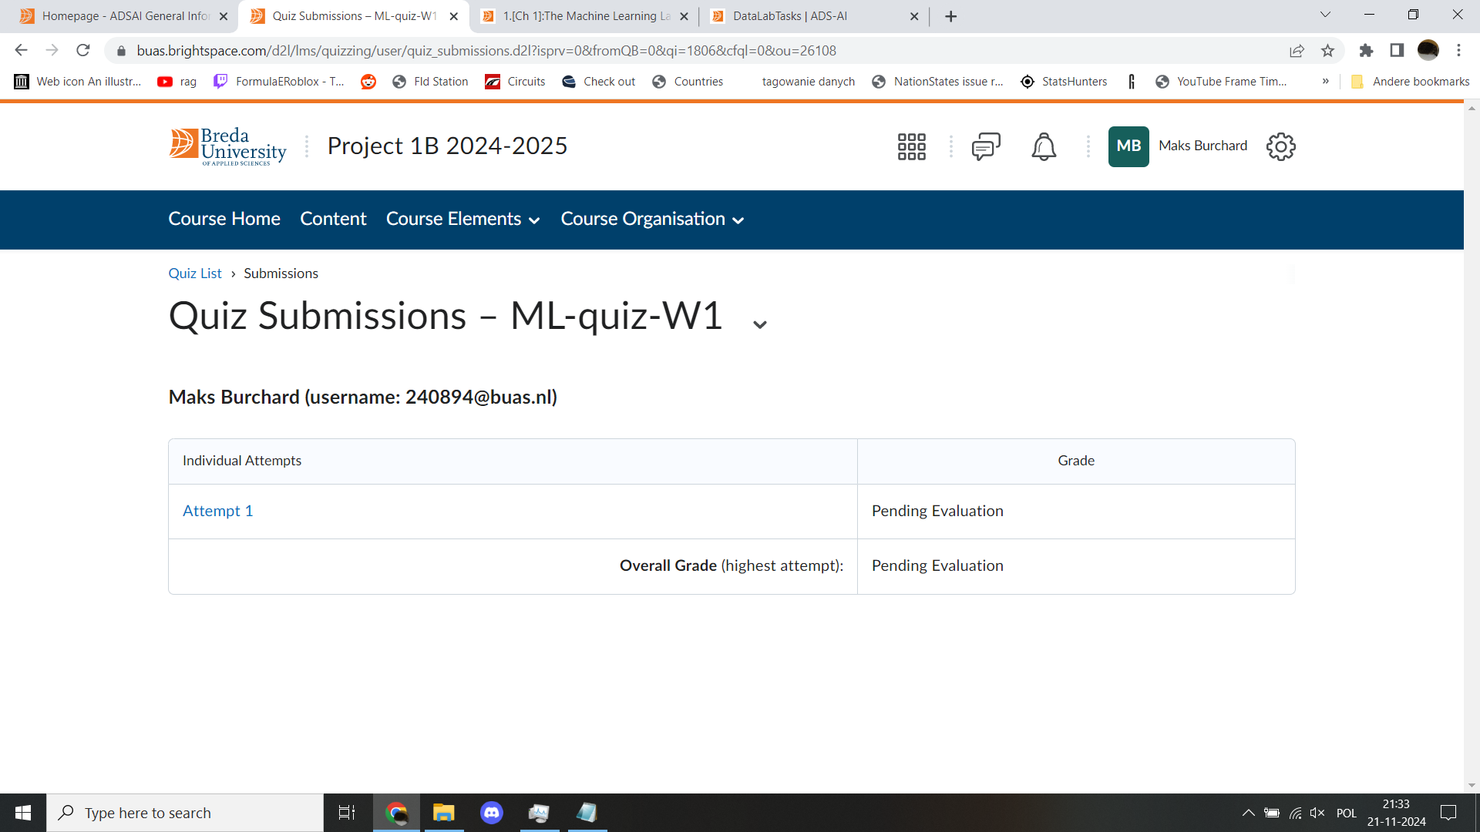
1
Week 1 - Log
1/2
What did you do?
Reflection
What goal(s) did you set for this week?
My goal this week is to just find my footing with this block and know and figure what this block is about.
What have you actually been able to do?
I have done what I believe to be expected of me. I have followed all required lessons and am planning to follow some optional material as well.
Showcase the evidence of your progress (production artifacts, short descriptions-links-pictures animated gifs, etc.)
How did the week go?
I had some problems with certain tasks, but in general did do a lot of work.
What went well?
Finding solutions to unexpected problems, such as figuring out the password to Postgresql or downloading the „credit.csv” file
What didn’t go so well?
Filling in and evidencing in the WorkLog, especially towards the end of the week.
What did you learn?
This week learned the basics of SQL and machine learning.
What could be added as an Action point looking forward to next week?
The WorkLog needs to be filled in correctly with regards to the tasks, evidence and reflection.
SMARTER-Goals reflections:
I have almost reached the 40 hours required for this week, and so I need to work 5 hours more in the next week to compensate for this. In terms of sleeping, I have not begun trying to set a rhythm yet.

Slide 10
1
Week 1 - Feedback
2/2
Team, individual, peer, workshop feedback
Jim Dücker There’s a couple of blocked tasks which don’t looks good but rest seems fine.
It‘s the first week so there‘s not really much to talk about.
Click for feedback delivery techniques!

Slide 11
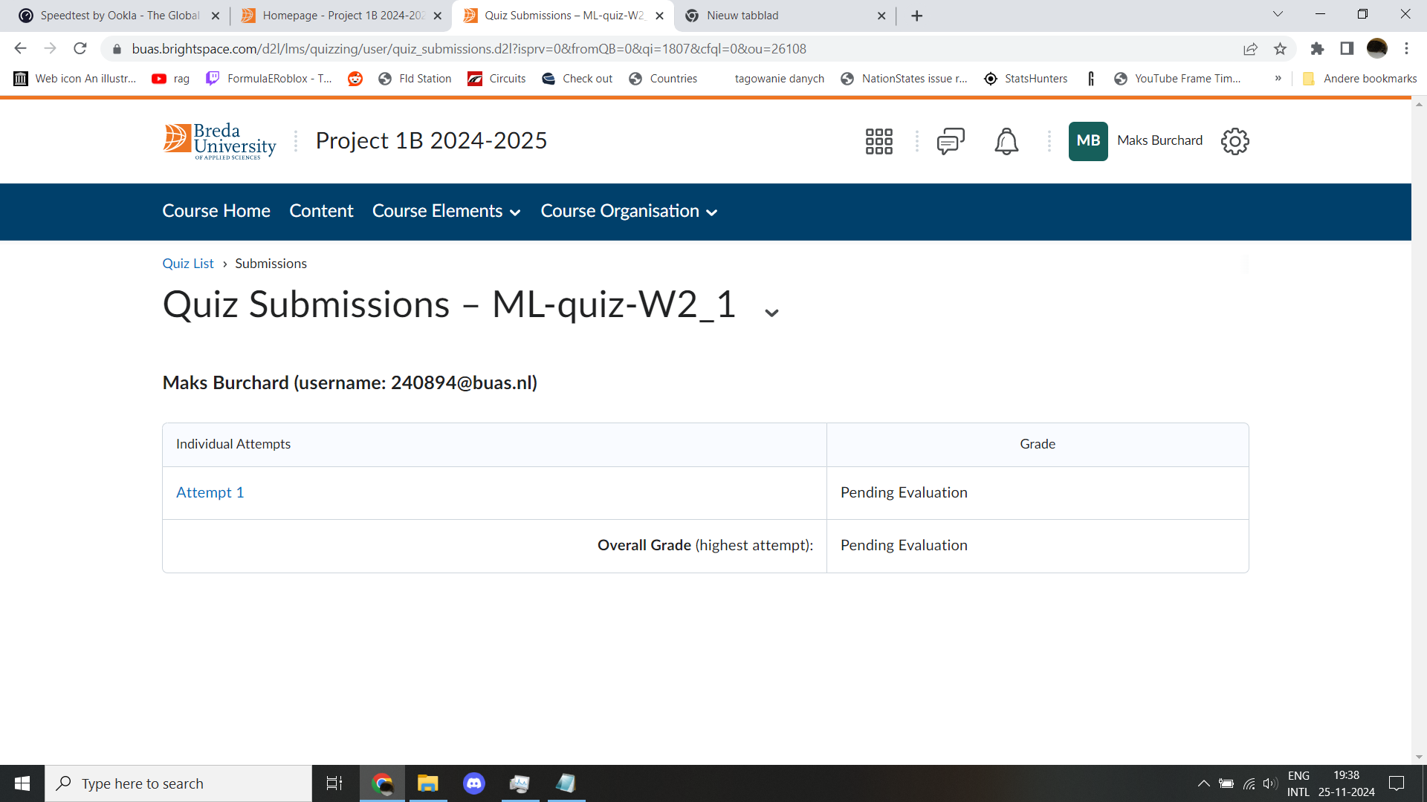
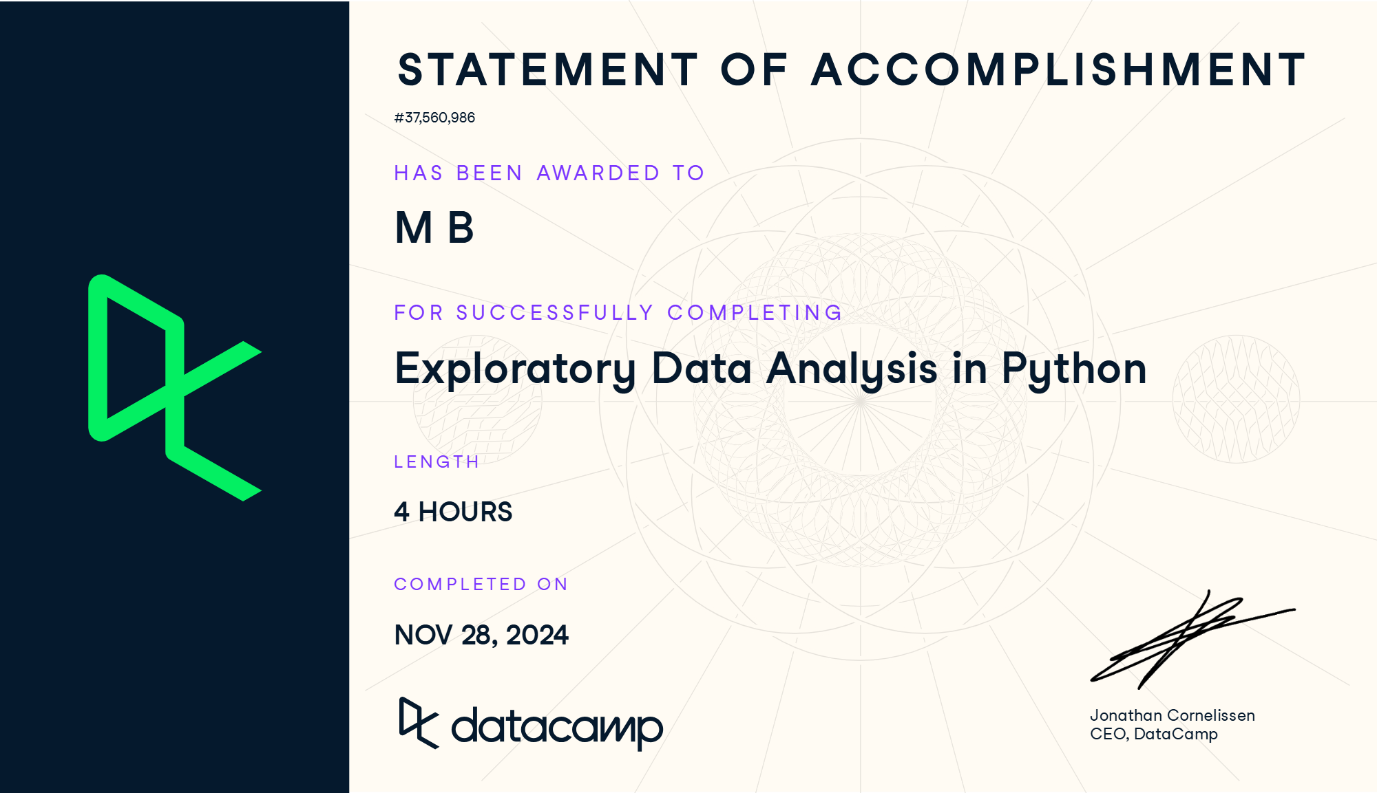
2
Week 2 - Log
1/2
What did you do?
Reflection
What goal(s) did you set for this week?
My goal for this week is to make sure I fill in the WorkLog correctly.
What have you actually been able to do?
I have filled in my Worklog better this week except for Friday where I forgot to fill it in after I returned home.
Showcase the evidence of your progress (production artifacts, short descriptions-links-pictures animated gifs, etc.)
How did the week go?
There were ups and downs during this week but on average I would say it went quite well.
What went well?
Following the content.
What didn’t go so well?
Finishing up my work.
What did you learn?
I learned some new concepts in the field of machine learning and EDA concepts.
What could be added as an Action point looking forward to next week?
Finishing some of my planned tasks that I did not finish during this week.
SMARTER-Goals reflections:
This week I did the tasks but I did finished them too fast and so I didn‘t reach the 40 hours required once again. I‘m making plans to implement a better sleeping schedule.

Slide 12
2
Week 2 - Feedback
2/2
Team, individual, peer, workshop feedback
Mentor I did a nice job of actually following the WorkLog but the evidencing needs to be done and what I wrote in the Learning Log needs to be a bit longer. I also went over what the SMARTER goals were due to me being a bit confused over them.
The WorkLog evidencing was obvious to me aswell. I also recieved the fedback about my texts in the Learning Log being too short last block, meaning it is something I need to be carefull about. I am thankfull for the SMARTER goals explanation.
Click for feedback delivery techniques!

Slide 13
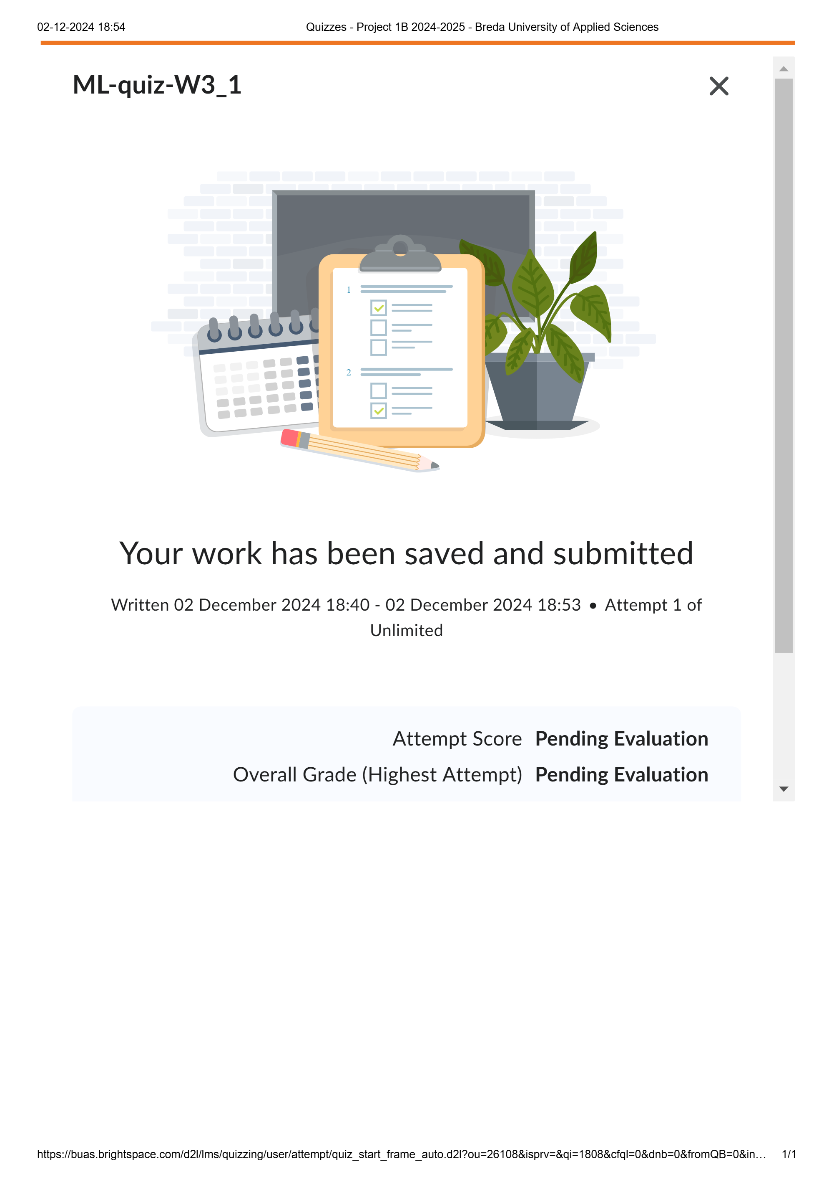

3
Week 3 - Log
1/2
What did you do?
Reflection
What goal(s) did you set for this week?
My goal for this week is to continue working with the tasks that have been given to me.
What have you actually been able to do?
I have continued working, just like I had planned.
Showcase the evidence of your progress (production artifacts, short descriptions-links-pictures animated gifs, etc.)
How did the week go?
The week went well this time.
What went well?
I got a lot of work done.
What didn’t go so well?
I did not get everything done and need to learn to finish up my work.
What did you learn?
I learned more concepts related to machine learning and re-learned the concept and rules of matrices.
What could be added as an Action point looking forward to next week?
I need to concentrate a bit better buring datalabs as my focus drifts off sometimes.
SMARTER-Goals reflections:
This week I got the closest to the 40 hours, but I have not reached it and I am falling more behind on the goal. I have made a plan for the sleep rhythm and I am planning on implementing it next week.

Slide 14
3
Week 3 - Feedback
2/2
Team, individual, peer, workshop feedback
Milo Everse Compared to the mentor feedback, the work this week was not sufficient.
I did not really attempt to adress the mentor feedback this week so during week 4 I will have to try and adress it. Feedback is fair.
Click for feedback delivery techniques!

Slide 15
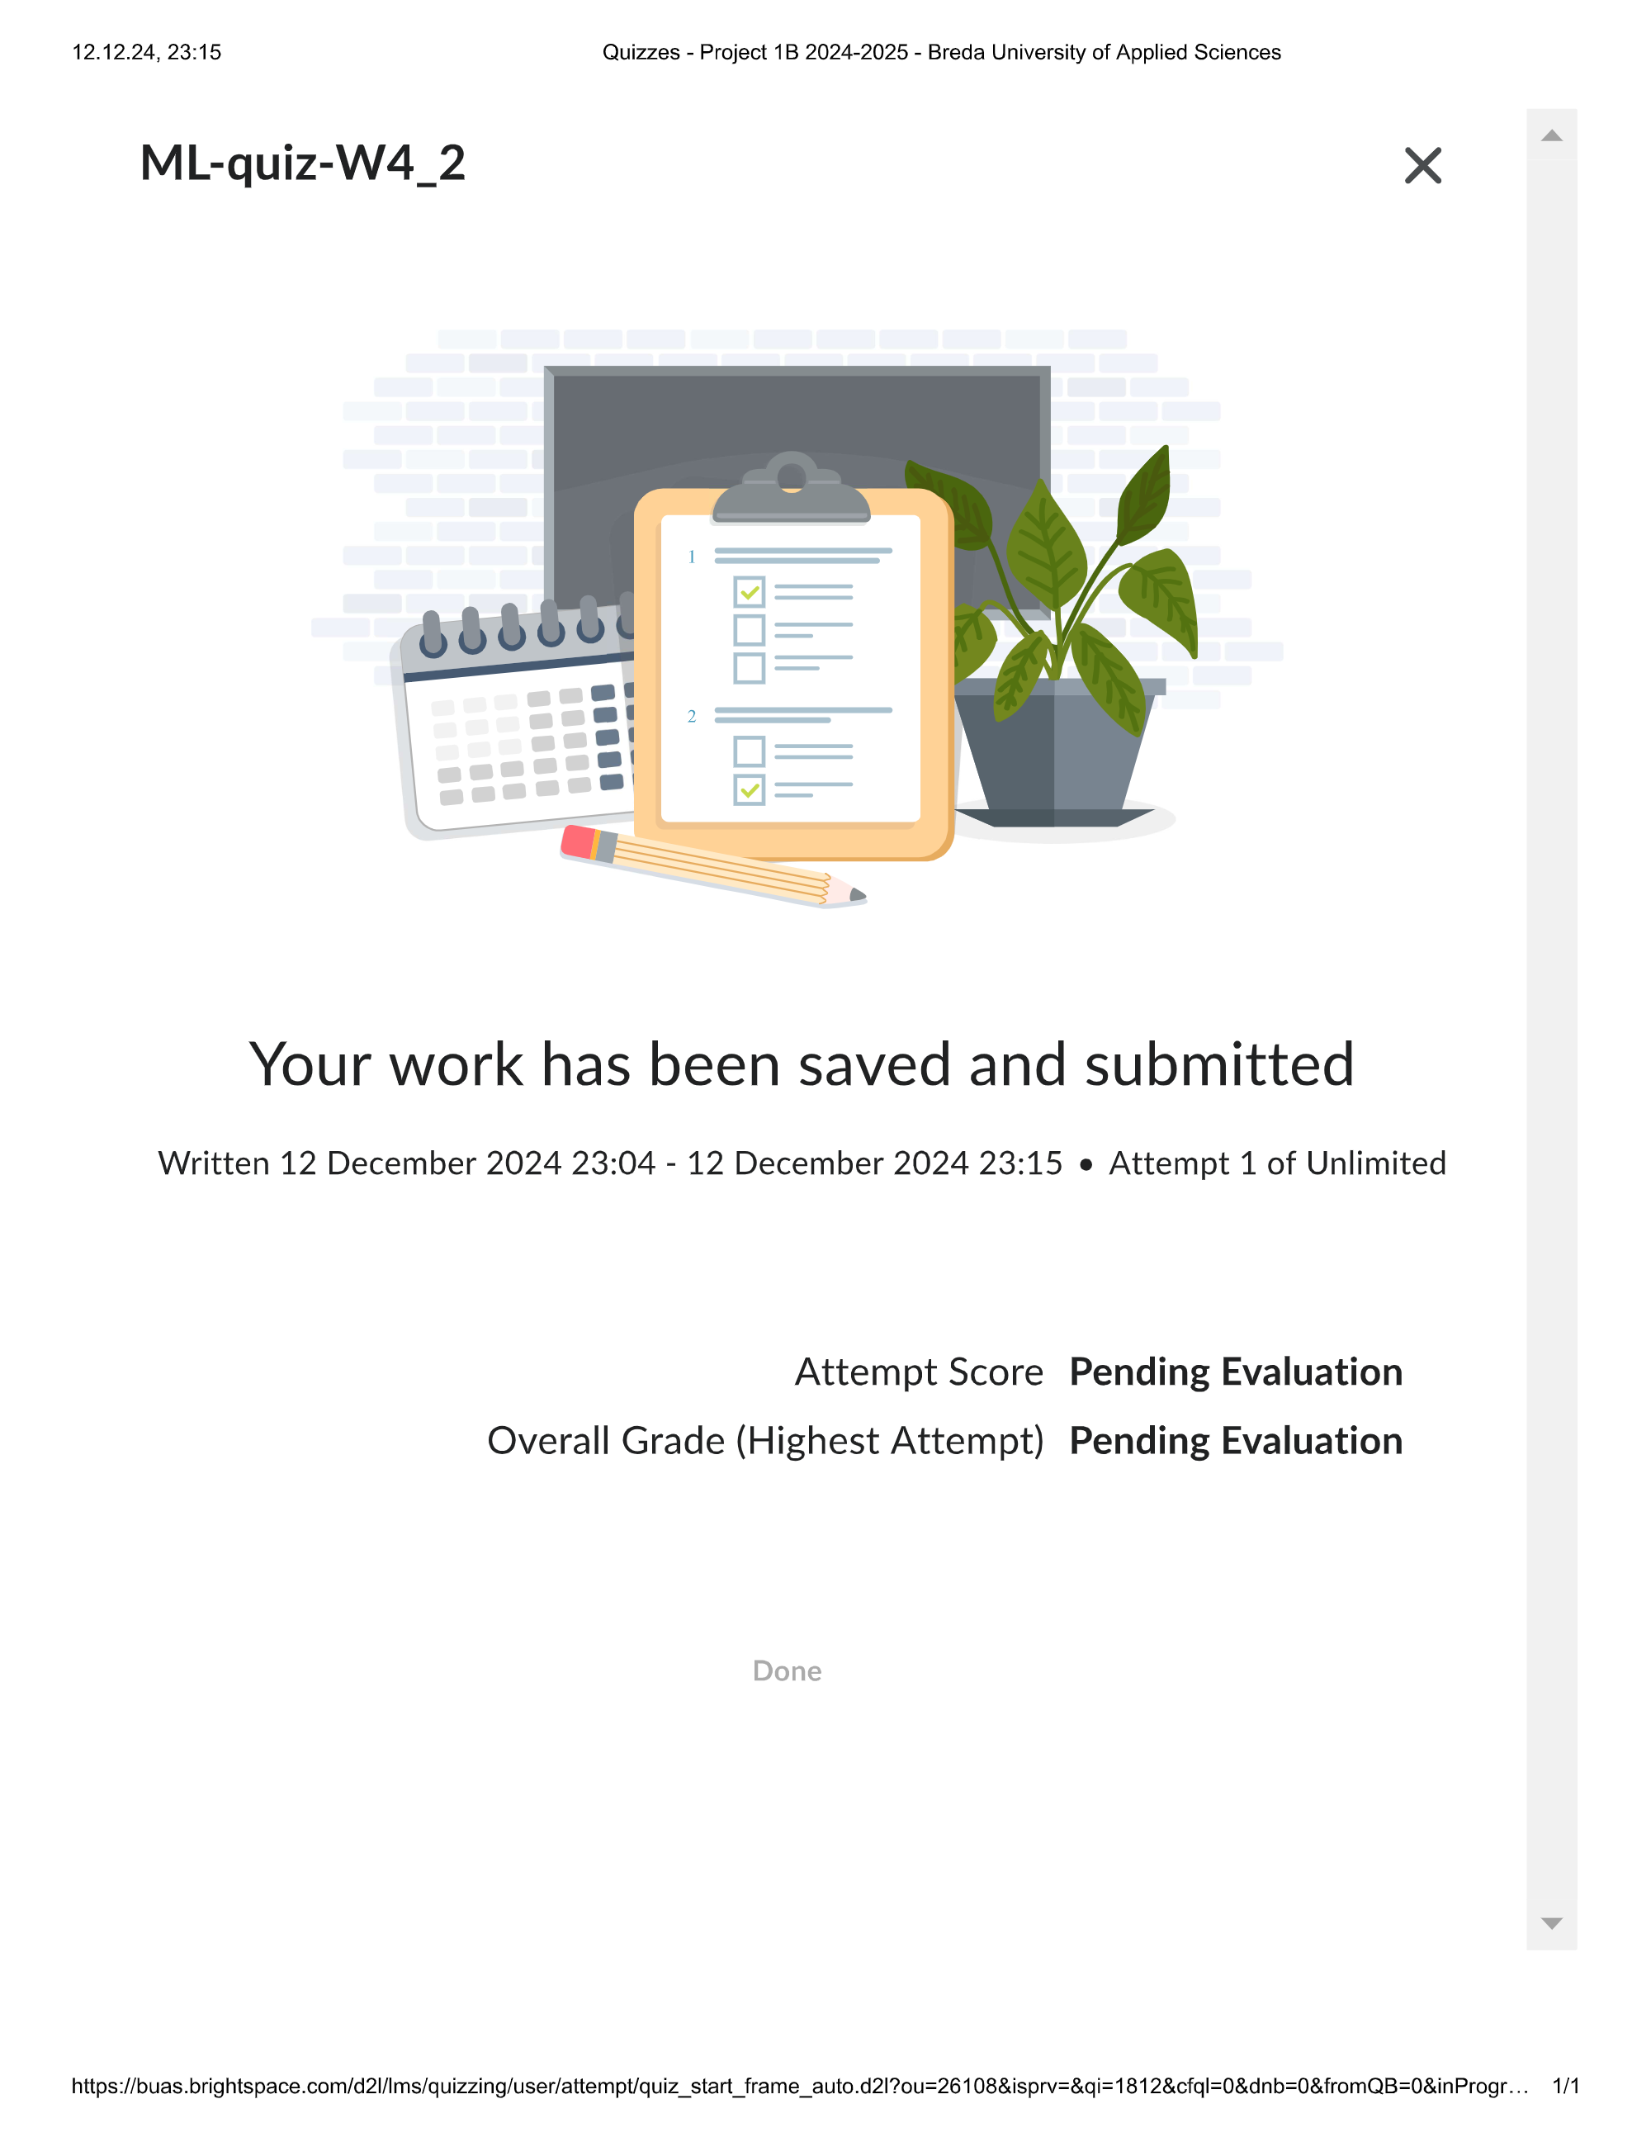
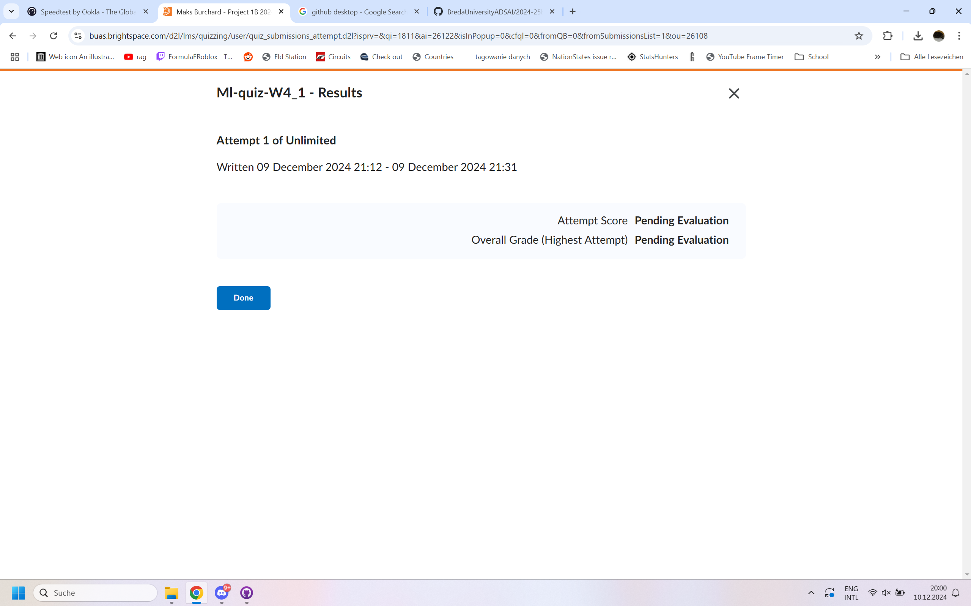
4
Week 4 - Log
1/2
What did you do?
Reflection
What goal(s) did you set for this week?
My goal this week is to mainly prepare for the Python retake on the 16th.
What have you actually been able to do?
I have prepared for the retake and continued working on the task from the other days that I was not sick.
Showcase the evidence of your progress (production artifacts, short descriptions-links-pictures animated gifs, etc.)
How did the week go?
The week began bad with me being sick but it did turn good as I prepared for the retakes.
What went well?
Preparation for the retakes.
What didn’t go so well?
On Tuesday and a bit on Wednesday I was sick, so I fell behind with the tasks for the week.
What did you learn?
I learned the theory behind concepts such as boosting, stacking, voting classifiers, and decision trees.
What could be added as an Action point looking forward to next week?
Finish some of the work I didn‘t this week.
SMARTER-Goals reflections:
Because I was sick this week I fell well short of the 40 hours. Considering we are halfway through this block, I may need to think about re-adjusting my first goal. My second goal has been helped by the sickness though as I have managed to somewhat keep to the plan I made in the previous weeks.

Slide 16
4
Week 4 - Feedback
2/2
Team, individual, peer, workshop feedback
Mentor The WorkLog had some problems, such as not having any evidence, having too little feedback/reflection, and not having filled in the “Task” column. The Learning Log had too few sentences in the “What did you do?” and “Reflection” parts and I should re-write some of them. In terms of programming, I am a bit behind the planning.
Most of the feedback is fair. The WorkLog evidence I have not done but I really should do, and at the moment I am planning to do that during the vacation, and the reflections have to be re-written too in the vacation. The “Task” part I only learned that day so I did not have the time to do it. The Learning Log feedback is the same as the previous time and I tried to address it, but apparently I did not too a good enough job. I knew that I was a bit behind as I was a bit sick this week.
Click for feedback delivery techniques!

Slide 17


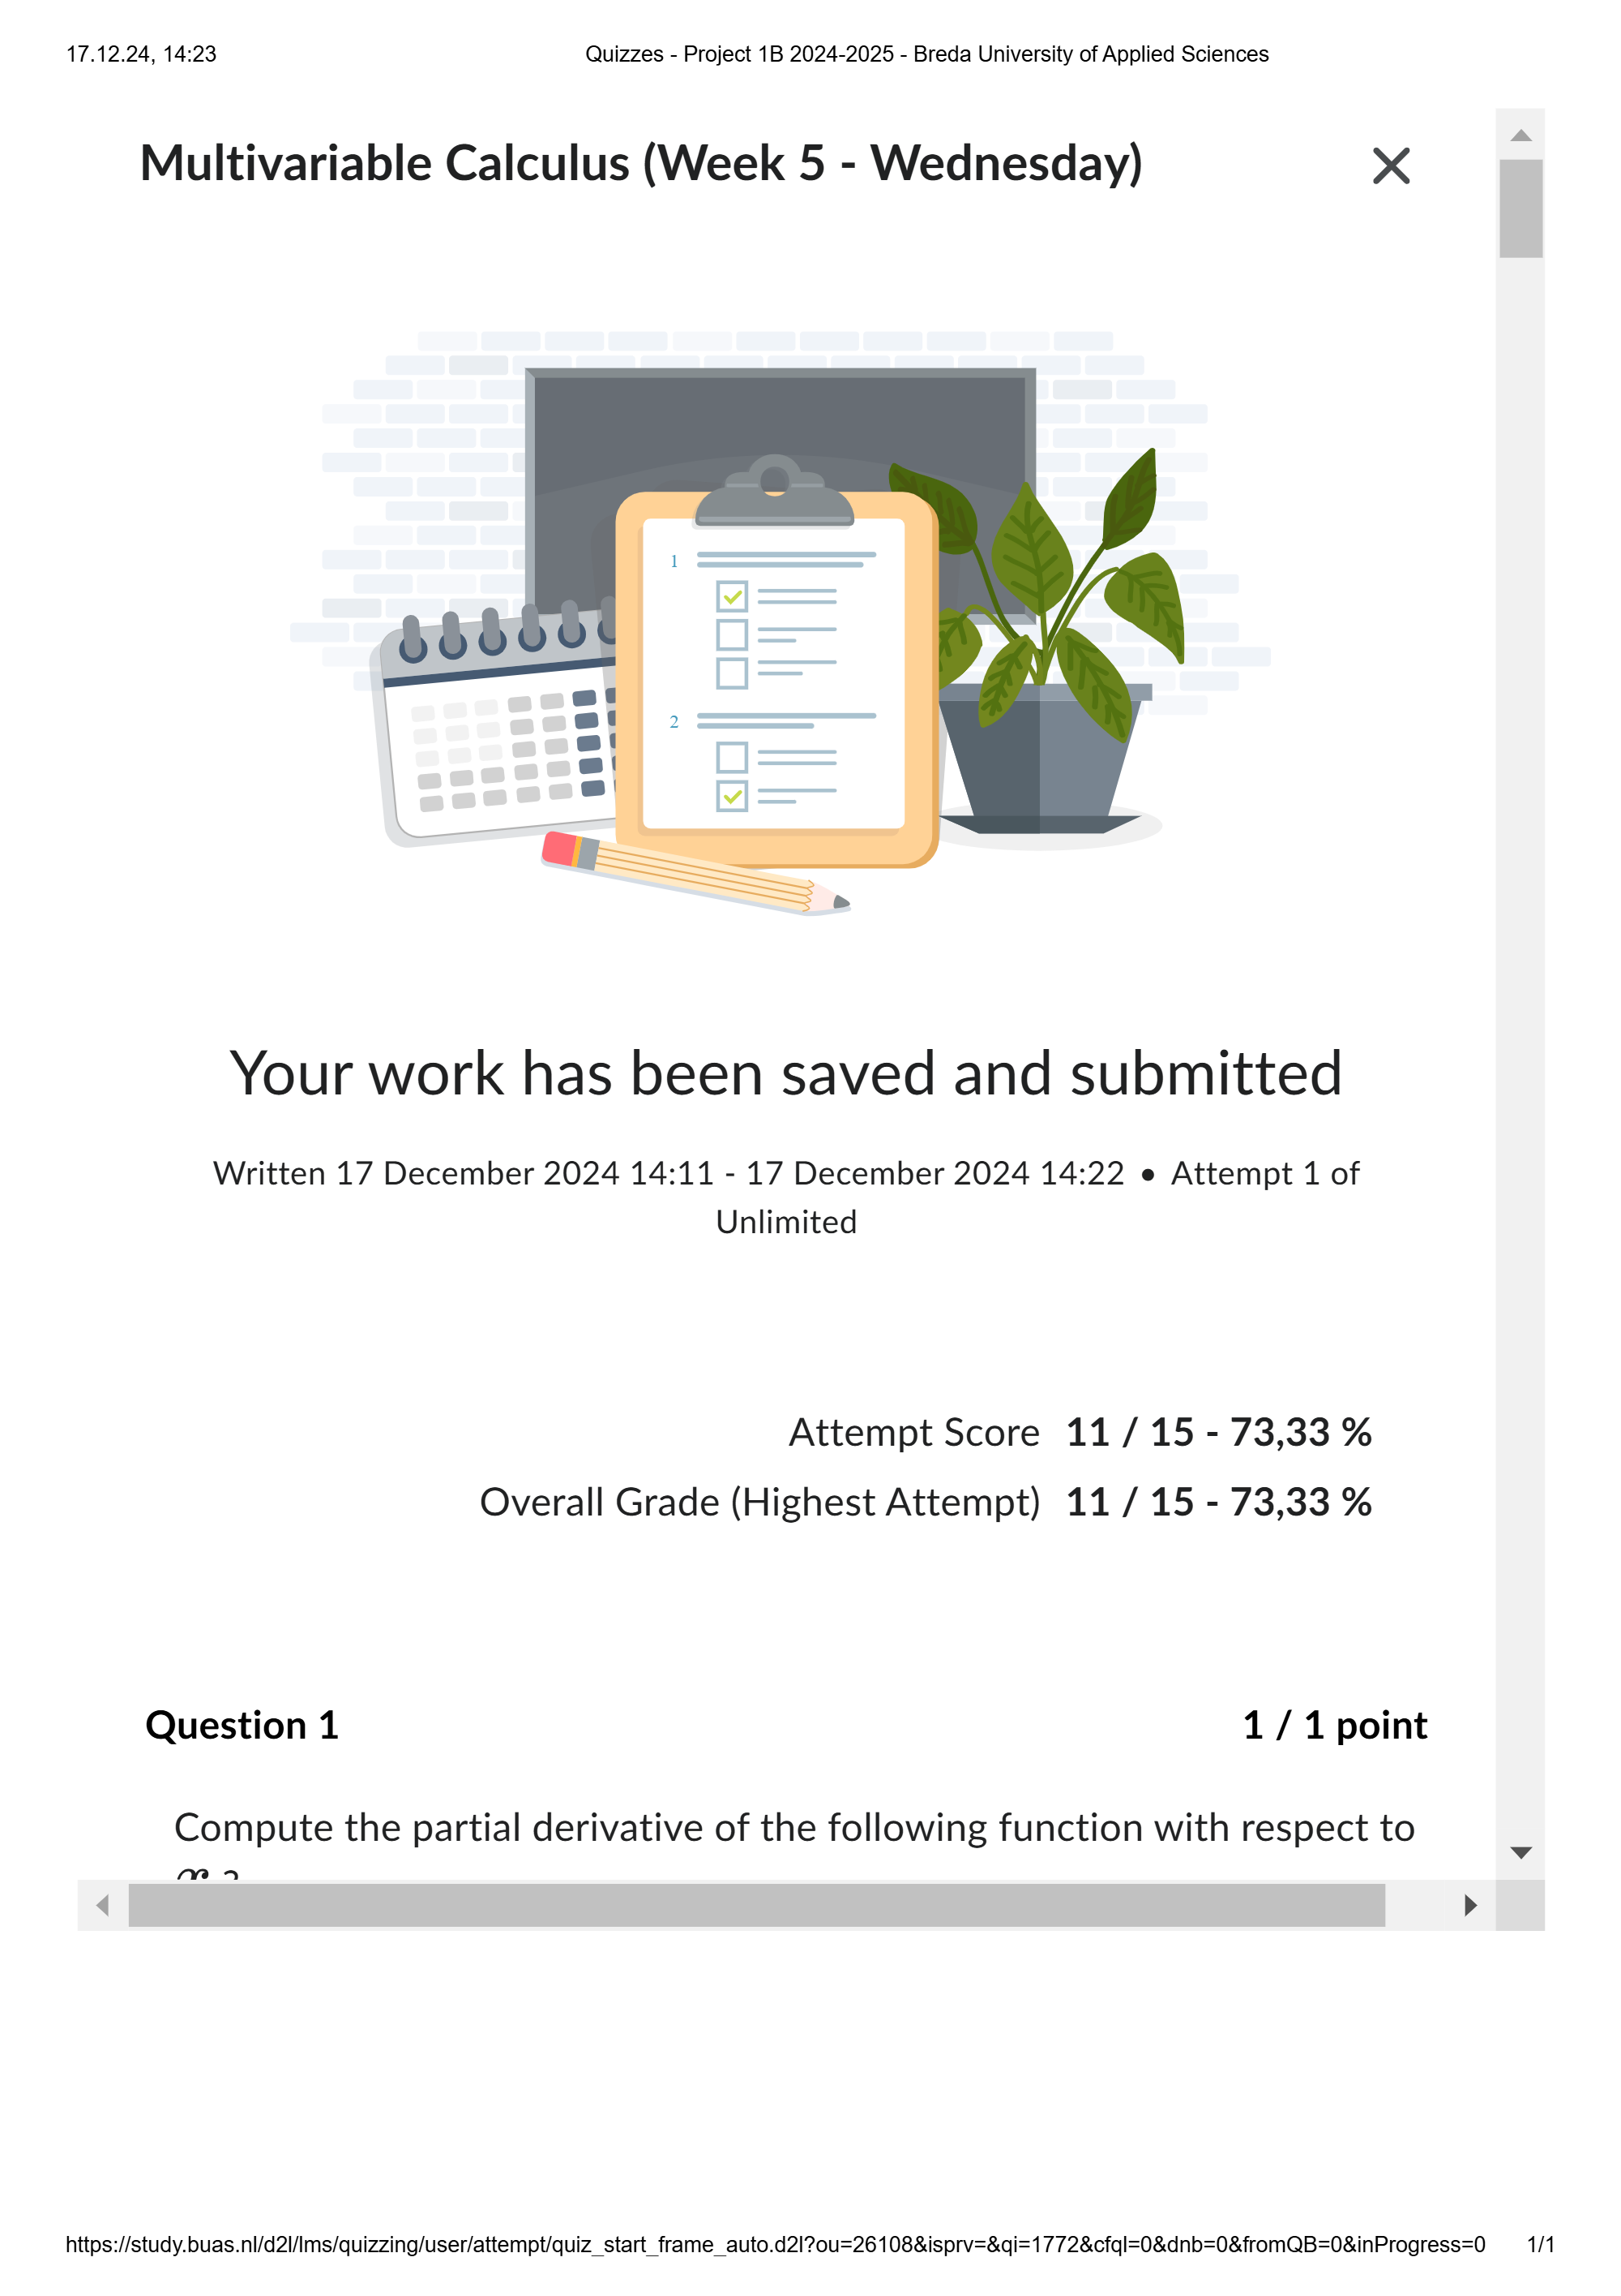
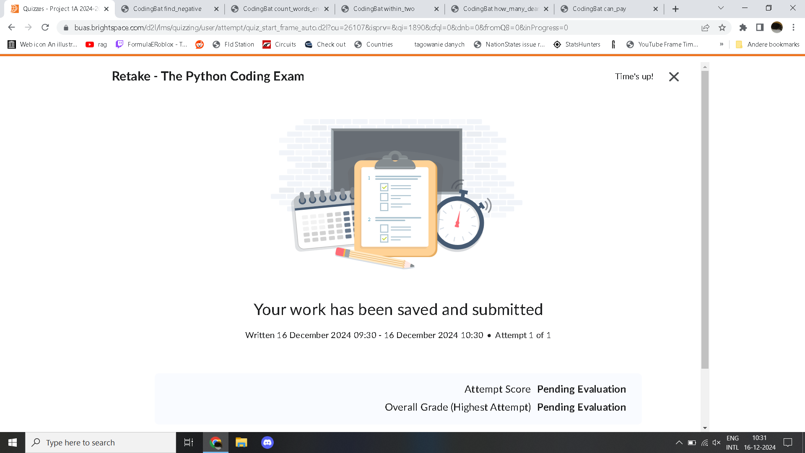
5
Week 5 - Log
1/2
What did you do?
Reflection
What goal(s) did you set for this week?
My goal this week is to continue working on the tasks for this week and to catch up on the missed tasks from last week.
What have you actually been able to do?
I did the Python exam on Monday and continued working as planned for the rest of the week.
Showcase the evidence of your progress (production artifacts, short descriptions-links-pictures animated gifs, etc.)
How did the week go?
The week went well.
What went well?
The python retake on Monday.
What didn’t go so well?
Evidencing in the Work- and Learning Logs.
What did you learn?
I learned more machine learning concepts from the book.
What could be added as an Action point looking forward to next week?
To have me evidence my work in the logs correctly.
SMARTER-Goals reflections:
While I came closer this week than last week to the 40 hours, I still fell short. During the vacation I may consider re-adjusting my first goal. I have kept to my plan in regards to my sleeping rhythm this week, but with the two weeks of vacation,

Slide 18
5
Week 5 - Feedback
2/2
Team, individual, peer, workshop feedback
Jim Dücker Everything seems to be going well, especially with the Python exam being done.
There’s no immediate problems to be noticed, so that’s good, but I need to ensure there’s nothing deeper causing problems.
Click for feedback delivery techniques!

Slide 19
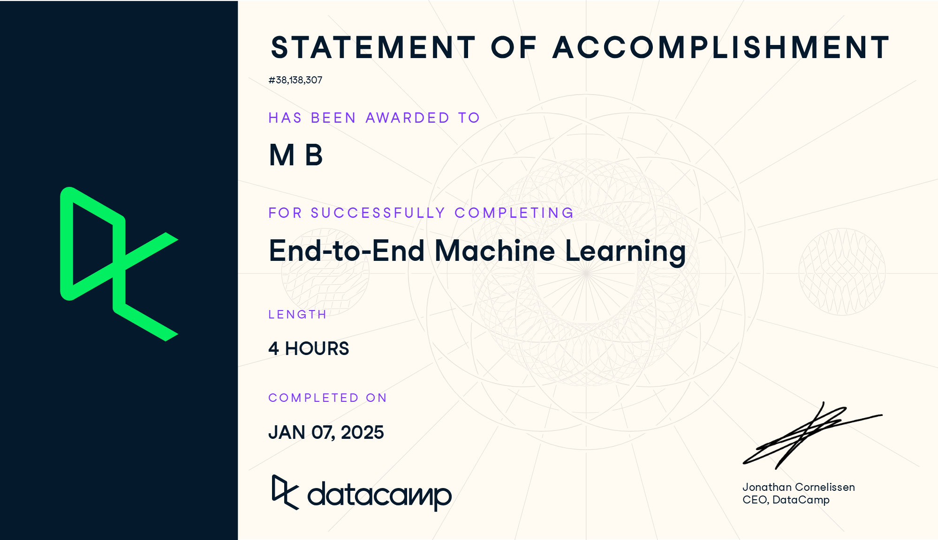
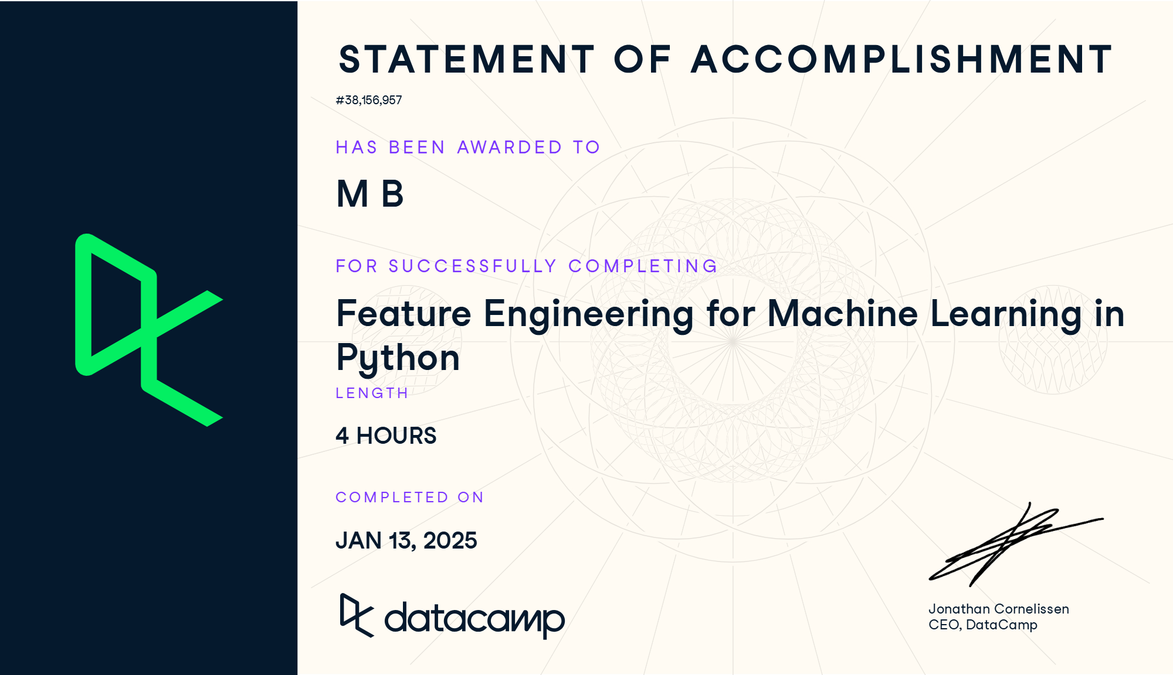
6
Week 6 - Log
1/2
What did you do?
Reflection
What goal(s) did you set for this week?
My goal this week is to continue working ans slowly prepare for the end of the block.
What have you actually been able to do?
Unfortunately I became sick in the latter half of the week and was not able to do everything I planned.
Showcase the evidence of your progress (production artifacts, short descriptions-links-pictures animated gifs, etc.)
How did the week go?
Not too great as I became sick in the latter part of the week.
What went well?
Not much, unfortunately, as I barely did any school work from Wednesday.
What didn’t go so well?
The week.
What did you learn?
Not much.
What could be added as an Action point looking forward to next week?
I need to catch up on tasks I missed this week.
SMARTER-Goals reflections:
During the vacation, I have readjusted my first Smarter goal from 320 hours down to 240 hours, at 30 hours per week, and I hope to not need to readjust it again after my sickness this week. My sleep rhythm has also been broken up by the vacation as I went to a different country where sunrise and sunset are at different times. I have to re-adjust again.

Slide 20
6
Week 6 - Feedback
2/2
Team, individual, peer, workshop feedback
Maks Burchard (self-reflection) Unfortunately, my sickness this week caused me both literal and figurative headaches. And while this has hurt my first SMARTER goals as I now need to do the work of two weeks in one week, it has helped me a bit with the second goal as I began sleeping earlier.
In week 7 I have to catch up and do more work than I normally do as in week 8 I will probably be busy working on finalising this block.
Click for feedback delivery techniques!

Slide 21

7
Week 7 - Log
1/2
What did you do?
Reflection
What goal(s) did you set for this week?
I need to catch up on work that I did not do last week due to sickness.
What have you actually been able to do?
I have caught up on all tasks bar 1 I missed, which I have begun working on at the start of week 8.
Showcase the evidence of your progress (production artifacts, short descriptions-links-pictures animated gifs, etc.)
How did the week go?
The week went very well and was very productive.
What went well?
Cathing up on work from the last week.
What didn’t go so well?
Nothing much went wrong.
What did you learn?
How to keep concentration and motivation for a pretty long.
What could be added as an Action point looking forward to next week?
I don‘t see anything from this week that could be added. I do need to work a lot next week as well as it is the final week.
SMARTER-Goals reflections:
Due to my sickness last week and need to catch up this week, the times for actual work this week have taken a hit while the actual time spent working has been the highest of all weeks. I have readjusted to the sleep schedule I had before the vacation.

Slide 22
7
Week 7 - Feedback
2/2
Team, individual, peer, workshop feedback
Jim Dücker Being behind on a task is not good, but for the rest everything seems fine.
I am still behind on some tasks due to my sickness last week, but I understand the concern, especially this close to the final deadline. The fact everything else seems fine is reassuring.
Click for feedback delivery techniques!

Slide 23
8
Week 8 - Log
1/2
What did you do?
Reflection
What goal(s) did you set for this week?
Do the final touches to my work this block and finish the block.
What have you actually been able to do?
I have finished all the documents that I needed to, from the creative brief & final report to the Work & Leaning Logs.
Showcase the evidence of your progress (production artifacts, short descriptions-links-pictures animated gifs, etc.)
Link to Creative Brief
Link to Final Report
Link to Final presentation
Link to Final presentation slides (PDF)
Link to Final WorkLog
Link to Final Learning Log
Link to Final self-assesment rubric
How did the week go?
The week went well as I worked quite a bit to finish all the required documents.
What went well?
Finishing all the documents.
What didn’t go so well?
Keeping track of the time during the tasks and leaving redoing the SQL part to almost the final day.
What did you learn?
How to work under pressure.
What could be added as an Action point looking forward to next week?
Don’t procrastinate under a deadline.
SMARTER-Goals reflections:
As of me writing this, I have achieved my first readjusted goal of 240 hours total work. That is a success. A for the second goal, I have shortened my sleeping schedule to try and get as much work done before the deadline. Overall, I would also say it is a success as I managed to say on the sleeping schedule for quite a while.

Slide 24
8
Week 8 - Feedback
2/2
Team, individual, peer, workshop feedback
Jim Dücker Presentation was minimalistic and could use some more style.
Fair enough, I did not really put much effort into the visualisation of my final presentations, which could be an action point for the next time I present.
Link to final presentation
Link to final presentation slides (PDF)
Click for feedback delivery techniques!

Slide 25
Section C
C
Progress
Intended Learning Outcomes
Notes:
MUST BE COMPLETED IN WEEK 8, BUT SHOULD BE UPDATED REGULARLY
This is where you link your evidence to each of the Intended Learning Outcomes of this block.

Slide 26
ILO 0.2
0
Foundational skills
The student masters the foundational skills and knowledge that form the basis of Data Science and Artificial Intelligence.

Slide 27
ILO 0
Foundational skills
The student masters the foundational skills and knowledge that form the basis of Data Science and Artificial Intelligence.
1/1
0.2
The students is able to demonstrate an advanced understanding of python programming concepts and basics of SQL.
pre-requisites | A (Points: 3) | B (Points: 3) | C (Points: 3) | D (Points: 3) | E (Points: 3)
The student should submit the relevant Python Notebooks addressing the creative brief. Student submits a complete learning log, work log and self-assessment rubric. The student exhibits professional behavior during the DataLab. | The student is able to demonstrate an understanding of the concept of working directory, file types and file structures in Python. | The student is able to perform basic data cleansing activities in Python with or without using packages. Additionally, the student is able to demonstrate significant understanding of Numpy. | The student is able to design reports and visuals (e.g., using matplotlib, Streamlit ) based on the merged datasets which help providing valuable and actionable insights. | The student demonstrates the capability to establish a connection between Python and a database, perform basic ETL operations such as read/write. | The student is able to join two different tables using SQL and uses this to fulfill the requirements of creative brief.
I have submitted a complete learning log, worklog and self-assessment rubric. Link to Python notebook Assignment 1 - Optimization Algorithms Link to Python notebook Linear Regression from Scratch Link to Python notebook Logistic Regression from Scratch Link to Python notebook Gradient Descent Algorithm for House Price Prediction | I have demonstrated my understanding of the working directory, file types and file structures in my creative brief. Specifically, I have shown my understanding of working directory by directly loading the files from the same folder. My understanding of file types and structures is shown in tasks 1 and 2 of the creative brief, as I do the EDA and process the data without any problems. Additional clarification of the creative brief can be found in the final report. Link to creative brief Link to final report | I have demonstrated my ability to perform data cleansing activities in the creative brief. Specifically, in task 1B and 2 in the creative brief, I show my ability to clean data. In task 1B.2, I use Numpy to load the data. Additionally, in the Python notebooks “Linear Regression from Scratch” and “Logistic Regression from Scratch”, I use Numpy to achieve both tasks. Additional clarification of the creative brief can be found in the final report. Link to Python notebook Linear Regression from Scratch Link to Python notebook Logistic Regression from Scratch Link to creative brief Link to final report | I have demonstrated my ability to design reports and visuals in the creative brief. Specifically, in task 2.1.3, I have created a host of visualizations, which I have justified in the final report. I also have used visualizations later in the creative brief, such as in tasks 3.2.5 and 3.3.3, which I have also justified in the final report. Link to creative brief Link to final report | I have demonstrated my ability to establish connections with a database in task 1A of the creative brief, where I used SQL to perform operations to a database. I have demonstrated basic ETL operations in task 1, 2, and 3.1.2 as I extracted, transformed and loaded the dataset within those tasks. Additional clarification of the creative brief can be found in the final report. Link to creative brief Link to final report | I have used SQL in task 1A of the creative brief. I have used said SQL to fulfill the requirements of the creative brief in task 1A. Additional clarification of the creative brief can be found in the final report. Link to creative brief Link to final report
Show your best examples, do not go overboard, add in short description, you are free to alter this layout (or add slides per evidence) to suit your needs. Just be sure that it is clear.

Slide 28
ILO 1.2
1
Professional practice
The student can collaborate (internationally) in multidisciplinary teams with different levels of knowledge in the field of data use and applications. They can set up and execute projects in collaboration with stakeholders and team members. They can act as a sounding board in discussions with team members, customers, users and experts. They strive for a good balance between input of their own vision and additional expertise of others. They are able to lead a team.

Slide 29
ILO 1
Professional practice
The student can collaborate (internationally) in multidisciplinary teams with different levels of knowledge in the field of data use and applications. They can set up and execute projects in collaboration with stakeholders and team members. They can act as a sounding board in discussions with team members, customers, users and experts. They strive for a good balance between input of their own vision and additional expertise of others. They are able to lead a team.
1/1
1.2
The student accurately tracks time spent on planned and unplanned work, noting reasons for and consequences of deviations from the planned objectives.
pre-requisites | A (Points: 2) | B (Points: 2) | B (Points: 2) | B (Points: 2) | B (Points: 2)
The student submits a complete learning log, work log and self-assessment rubric. The student exhibits professional behavior during the DataLab. | The student outlines the completed tasks in the worklog, with detailed comments provided where necessary. | The student writes professional and critical reflections with time-tracking and identifying key lessons. | The student fills out the worklog for each of the weeks. | The student includes all references to important resources in the worklog for the listed tasks. | The student's writing style in worklog is professional and free of spelling and grammar mistakes. The student comprehends what was completed and why individual and project feedback was given.
I have submitted a complete learning log, worklog and self-assessment rubric. | I have outlined all of my tasks, both completed and incomplete, in the worklog. I have given commentary where necessary, such as incomplete tasks and tasks that took a significant amount of time longer or shorter to complete | I have written professional and critical reflections in section B of this learning log. I have also identified key lessons in the same section. I have tracked the time in the worklog. | I have filled out my worklog for each and every week. | I have included references to as many resources as I could in the worklog for the listed task. This includes both important and unimportant tasks. I have done this to make sure I did not miss any references to important tasks, as I have trouble placing myself in the mind of others and seeing what they may find important. | I believe my writing style is professional. I have checked for spelling and grammar mistakes in the worklog. I believe I am able to comprehend what was completed, as shown by my creative brief and final report, and to comprehend why individual and project feedback was given, as shown by my responses to the feedback I received in section B of this learning log. Link to creative brief Link to final report
Show your best examples, do not go overboard, add in short description, you are free to alter this layout (or add slides per evidence) to suit your needs. Just be sure that it is clear.

Slide 30
ILO 2.2
2
Personal development & Academic practice
The student applies relevant (research) methods and techniques in combination with relevant and adequate argumentation. They can reflect on (business) processes and their role in them, both theoretically and practically, by constantly evaluating their own actions and adapting them with input from others. They can translate the result of the reflection into concrete personal learning objectives.

Slide 31
ILO 2
Personal development
The student applies relevant (research) methods and techniques in combination with relevant and adequate argumentation. They can reflect on (business) processes and their role in them, both theoretically and practically, by constantly evaluating their own actions and adapting them with input from others. They can translate the result of the reflection into concrete personal learning objectives.
1/1
2.2
The student shows knowledge of leadership skills by taking on the role of a leader and supporting others in being a leader.
pre-requisites | A (Points: 5) | B (Points: 5)
The student submits a complete learning log, work log and self-assessment rubric. The student exhibits professional behavior during the DataLab. | Goals written with a SMARTER method. The goals are shown to be Specific, Measurable, Achievable, Relevant, Time-bound, Evaluated and Readjusted. Project goals and self-development goals detailed. | Goals are aligned with project, personal, and professional development objectives. A detailed evaluation of the goals has been conducted throughout the block. The goals may have been re-adjusted as well.
I have submitted a complete learning log, worklog and self-assessment rubric. | I have written goals with a SMARTER method. I have made specific, measurable, achievable, relevant, and time-bound goals. I have evaluated and readjusted the goals throughout the block, as noted in section B of this learning log. | I have aligned one goal, goal 1, with project and professional development objectives and the other goal, goal 2, with personal development objectives. I have evaluated and readjusted the goals throughout the block, as noted in section B of this learning log.
Show your best examples, do not go overboard, add in short description, you are free to alter this layout (or add slides per evidence) to suit your needs. Just be sure that it is clear.

Slide 32
ILO 6.2
6
Data Collection and Processing
The student masters (technological) skills to acquire, pre-process, process and manage the necessary data to create value for individuals, organizations and domains.

Slide 33
ILO 6
Data Collection and Processing
The student masters (technological) skills to acquire, pre-process, process and manage the necessary data to create value for individuals, organizations and domains.
1/1
6.2
The students is able to perform basic ETL operations such as read/write, clean, and explore data using standard Python libraries.
pre-requisites | A (Points: 5) | B (Points: 5)
The student should submit the relevant Python Notebooks addressing the creative brief. Student submits a complete learning log, work log and self-assessment rubric. The student exhibits professional behavior during the DataLab. | The student is able to clean and pre-process and visualise data using Python libraries. | The student is able to use metadata from the dataset to analyse the different types of data with describing the role (e.g. id / feature/ target) as well as detecting missed values.
I have submitted a complete learning log, worklog and self-assessment rubric. Link to Python notebook Assignment 1 - Optimization Algorithms Link to Python notebook Linear Regression from Scratch Link to Python notebook Logistic Regression from Scratch Link to Python notebook Gradient Descent Algorithm for House Price Prediction | I have shown my ability to clean, pre-process and visualize data using Python libraries in the creative brief. Specifically in tasks 2 and 3.1.2, I have shown both that I am able to clean the data by dealing with missing values and removing duplicate rows. In tasks 2 and 3.1.2, I have shown that I am able to pre-process data by encoding, scaling and splitting the data. In task 2.1.3, I have created a host of visualizations, which I have justified in the final report. I also have used visualizations later in the creative brief, such as in tasks 3.2.5 and 3.3.3, which I have also justified in the final report. Link to creative brief Link to final report | In task 2.2.1, I called up the metadata of the dataset and then analysed it in the final report. In tasks 1A.2 and 2.2.2 I identified missing data, which I dealt with in task 3.1.2. Link to creative brief Link to final report
Show your best examples, do not go overboard, add in short description, you are free to alter this layout (or add slides per evidence) to suit your needs. Just be sure that it is clear.

Slide 34
ILO 8.1
8
Modelling
The student can apply modelling techniques including Machine Learning and AI to create value for individuals, organizations and domains.

Slide 35
ILO 8
Modelling
The student can apply modelling techniques including Machine Learning and AI to create value for individuals, organizations and domains.
1/1
8.1
The student is able to understand different types of supervised and unsupervised machine learning algorithms for data analysis and can implement these to solve a business objective using industry standard Python libraries.
pre-requisites | A (Points: 4) | A (Points: 4) | A (Points: 4) | A (Points: 4) | A (Points: 4)
The student has a sufficient knowledge about ML algorithms. The student submits a complete learning log, work log and self-assessment rubric. The student exhibits professional behavior during the DataLab. . | The student is able to understand regression concepts and build a regression baseline using dataset. | The student is able to understand classification concepts and build a classification baseline using dataset | The student is able to understand clustering concepts and build a clustering baseline to segment patients into clusters using dataset. | The student is able to do the feature selection and engineering in dataset and is able to improve their model by tuning its hyperparameter(s) using a validation set and justify their model improvement(s) in the context of the business objective. | The student is able to analyse and interpret the results obtained from the ML algorithms for model selection based on the solution requirements and dataset features.
I have submitted a complete learning log, worklog and self-assessment rubric. I believe I posses a sufficient amount of knowledge about ML algorithms, as shown by my ability to create and use them in the creative brief and to clarify certain parts of them in the final report. Link to creative brief Link to final report | I can understand and implement regression concepts, as shown by my creative brief, Python notebooks, and final report. Specifically, task 3.1 covers regression. Link to Python notebook Linear Regression from Scratch Link to creative brief Link to final report | I can understand and implement classification concepts, as shown by my creative brief, Python notebooks, and final report. Specifically, task 3.2 covers classification. Link to Python notebook Logistic Regression from Scratch Link to creative brief Link to final report | I can understand and implement classification concepts, as shown by my creative brief and final report. Specifically, task 3.3 covers clustering. Link to creative brief Link to final report | I can understand and implement feature engineering and hyperparameter tuning, as shown by my creative brief and final report. Specifically, task 3.4 and 3.5 cover feature engineering and hyperparameter tuning. Link to creative brief Link to final report | I can understand, analyse, and interpret the results as required by this ILO as shown by my creative brief and final report. Specifically, task 3.6 covers feature engineering and hyperparameter tuning. In the final report, additional analysis and interpretation is shown in part 4. Link to creative brief Link to final report
Show your best examples, do not go overboard, add in short description, you are free to alter this layout (or add slides per evidence) to suit your needs. Just be sure that it is clear.

Slide 36
ILO 8.2
8
Modelling
The student can apply modelling techniques including Machine Learning and AI to create value for individuals, organizations and domains.

Slide 37
ILO 8
Modelling
The student can apply modelling techniques including Machine Learning and AI to create value for individuals, organizations and domains.
1/1
8.2
The student is able to perform elementary operations on matrices and understand the concepts of derivatives, gradients, optimization algorithms, and can implement a simple machine learning model from scratch.
pre-requisites | A (Points: 4) | A (Points: 4) | A (Points: 4) | A (Points: 4) | A (Points: 4)
The student submits a complete learning log, work log and self-assessment rubric. The student exhibits professional behavior during the DataLab. | The student demonstrate a comprehensive understanding of key optimization algorithms, critically analyse their performance, and apply them to solve complex minimization and maximization problems. Furthermore, the student will have the capability to assess the impact of algorithm parameters on performance and convergence in mathematical optimization. | The student implement all steps of training a regression model from scratch for their project, including implementing the cost function and finding its derivative, training the model using an optimization algorithm, evaluating the model's performance using appropriate regression metrics, and performing accurate predictions based on the trained model. | The student conduct fine-tuning of hyperparameters for regression models implemented from scratch, which includes implementing the regularized form of the cost function, testing different optimization algorithms (modifying them as necessary when incorporating regularization), studying the impact of learning rates on training performance, and examining how scaling features influences model performance and generalization. | The student implement all steps of training a classification model from scratch for their project, including defining the cost function and calculating its derivative, training the model using an optimization algorithm, evaluating the model's performance with relevant classification metrics, and making accurate predictions based on the trained model. | The student carry out hyperparameter fine-tuning for classification models developed from scratch, focusing on testing various optimization algorithms (modifying them as necessary to integrate regularization), implementing the regularized form of the cost function, analyzing the effects of learning rates on training performance, and assessing how scaling features affects model performance and generalization.
I have submitted a complete learning log, worklog and self-assessment rubric. | I have demonstrated all the required skills for this ILO in two Python notebooks, “AlgebraicExample” and “PricePred”. Both are linked below. Link to Python notebook Assignment 1 - Optimization Algorithms Link to Python notebook Gradient Descent Algorithm for House Price Prediction | have demonstrated all the required skills for this ILO in the Python notebook “LinearRegression”, which is linked below. Link to Python notebook Linear Regression from Scratch | have demonstrated all the required skills for this ILO in the Python notebook “LinearRegression”, which is linked below. Link to Python notebook Linear Regression from Scratch | have demonstrated all the required skills for this ILO in the Python notebook “LogisticRegression”, which is linked below. Link to Python notebook Logistic Regression from Scratch | have demonstrated all the required skills for this ILO in the Python notebook “LogisticRegression”, which is linked below. Link to Python notebook Logistic Regression from Scratch
Show your best examples, do not go overboard, add in short description, you are free to alter this layout (or add slides per evidence) to suit your needs. Just be sure that it is clear.

Slide 38
ILO 11.1
11
Reporting and Advising
The student can translate (interim) results into effective reporting. They see opportunities and possibilities and can translate these from a market-oriented vision into new concepts, products or services, while keeping the business side of the organization in mind.

Slide 39
ILO 11
Reporting and Advising
The student can translate (interim) results into effective reporting. They see opportunities and possibilities and can translate these from a market-oriented vision into new concepts, products or services, while keeping the business side of the organization in mind.
1/1
11.1
The student is able to communicate technical concepts by means of a structured, coherent, and well-formatted professional report.
pre-requisites | A (Points: 3) | B (Points: 3) | C (Points: 3) | D (Points: 3) | E (Points: 3)
The student should present final project and be able to answer the questions related to it during the presentation. The student submits a complete learning log, work log and self-assessment rubric. The student exhibits professional behavior during the DataLab. | The student is able to define the sections (EDA, Regression, Classification, Clustering, Evaluation, Improvement) clearly based on implementations. | The students is able to demonstrate an advanced understanding of machine learning concepts. | The student is able to demonstrate understanding of different types of machine learning algorithms for data analysis and have implementation of baselines based on the defined project and dataset. | The student is able to critically analyse and evaluate their proposed solutions based on its relevance for the business objectives. . | The student has a clean and commented code and is able to identify the shortcomings of the current implementation and propose next steps for improving the quality of implementation.
I have submitted a complete learning log, worklog and self-assessment rubric. I have presented my presentation in week 8 on Friday. Link to final presentation Link to final presentation slides (PDF) | I have defined the sections clearly in both my creative brief and final report. Link to creative brief Link to final report | I have compared and described different machine learning models I used in my creative brief in my final report. Link to creative brief Link to final report | I have demonstrated my ability to understand the different types of machine learning algorithms both in my implementation of them in the creative brief and my analysis of them in the final report. Link to creative brief Link to final report | I have critically analysed and evaluated my proposed solutions based on my creative brief in the final report. Link to creative brief Link to final report | I have all my code in the creative brief. I believe it is clean and commented where necessary. I have identified shortcomings and proposed potential steps for improving the quality in the Final Report. Link to creative brief Link to final report
Show your best examples, do not go overboard, add in short description, you are free to alter this layout (or add slides per evidence) to suit your needs. Just be sure that it is clear.

Slide 40

Medal Challenges
Going the extra mile!

Slide 41
Medal Challenges
Going the extra mile!
1/1
Put your evidence down here to receive a medal!
Show your best examples, do not go overboard, add in short description, you are free to alter this layout (or add slides per evidence) to suit your needs. Just be sure that it is clear.

Slide 42
Section D
D
Reflection
Notes:
MUST BE COMPLETED IN WEEK 8
Summative reflection on your progress during the block including a critical assessment of everything you did and learned during the block. This is a comprehensive review of everything recorded in Section B, evaluated against the goals and planning laid out in Section A.

Slide 43
D
What did I achieve this block?
1/2
My most significant achievements this block
Pulling through.
Might not seem like much but for me the ups and downs this block felt like mountains and valleys.
My most difficult challenges this block
Me getting sick twice in two different weeks forced me to have to almost double my workrate the next week. Especially with week 6/7, where the deadline was already looming, I had some doubts about myself and whether I was going to achieve the block. Hopefully, everything has paid off.
The most important lessons I learned
I learned how to persevere through tough times.

Slide 44
D
How well am I progressing?
2/2
Reflection on my self assessment My self assessment grade is a
8.3
(note: I believe there may be a mistake in the self-assesment rubric as the points for ILO 2 are multiplied by 2, so therefore my grade would be 7.4)
An 8.3, and even a 7.4 seem unbelievebly high considering how tough I thought this block to be.
How I plan to improve next block
I need to improve on mitigating the effects of the tough times.

